Slide 1
Microsoft Defender Quick Overview
Peter Perov

Slide 2
Microsoft Defender
Quick overview

Slide 3
Agenda
Intro
Overview
Defender for Endpoint
Defender for O365
Defender for Identity
Defender for Cloud Apps

Slide 4
Question was asked
Is Defender for Cloud same as Defender for Cloud Apps (previously Microsoft Cloud App Security)?

Slide 5
Overview
Previously known as Azure Security Center
Centralized hub for all things security on the cloud

Slide 6
Microsoft 365 Defender services
Defender for Endpoint Servers VMs Devices | Defender for Office 365 Modern Workplace | Defender for Identity Active Directory on prem Azure Active Directory | Defender for Cloud Apps Cloud Access Security Broker (CASB)
Notes:
Microsoft Defender is a unified enterprise Defense Suite
https://docs.microsoft.com/en-us/microsoft-365/security/defender/microsoft-365-defender?view=o365-worldwide
Defender for Cloud Apps – Formerly Cloud App Security

Slide 7
Microsoft 365 Defender
https://security.microsoft.com/homepage

Slide 8
Defender Plans
Microsoft Defender for servers
Microsoft Defender for Storage
Microsoft Defender for SQL
Microsoft Defender for Containers
Microsoft Defender for App Service
Microsoft Defender for Key Vault
Microsoft Defender for Resource Manager
Microsoft Defender for DNS
Microsoft Defender for open-source relational databases
Microsoft Defender for Azure Cosmos DB (Preview)
Microsoft Defender for IoT
Notes:
A Lot!

Slide 9
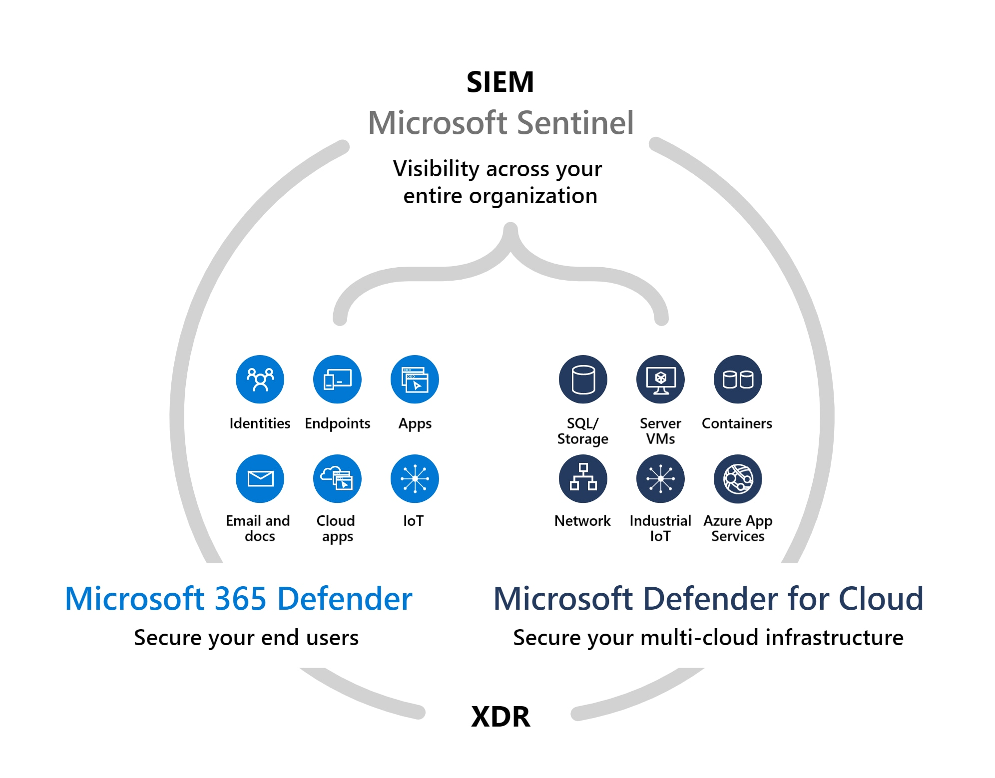
Notes:
Microsoft Sentinel is a cloud-native SIEM tool; Microsoft 365 Defender provides XDR capabilities for end-user environments (email, documents, identity, apps, and endpoint);
and Microsoft Defender for Cloud provides XDR capabilities for infrastructure and multi-cloud platforms including virtual machines, databases, containers, and IoT.
https://www.microsoft.com/en-ie/security/business/threat-protection

Slide 10



Microsoft Defender for Cloud overview
Strengthen your cloud security posture
Leveraging Azure Arc
Protect your multicloud
and hybrid workloads
Secure score
Policies and compliance
Automation
Servers
Cloud native workloads
Databases and storage
Azure service layers
IoT devices
Streamline security management
Notes:
​

Slide 11
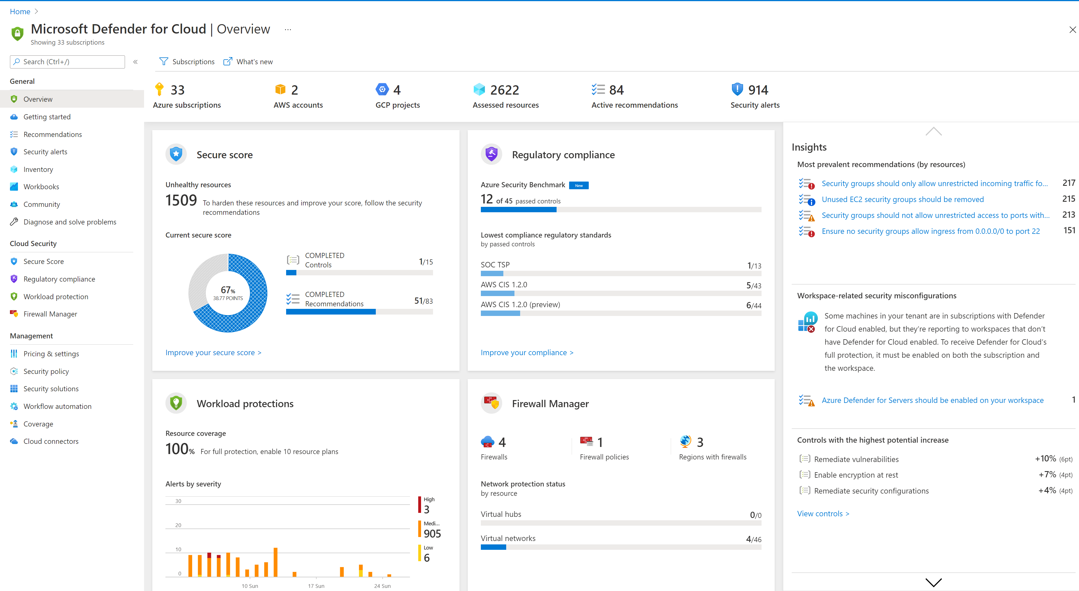
The security dashboard
Unified resource view
All your cloud resources in one place: Azure, AWS, on premises and other clouds
Focused views for security posture, compliance, and workload protection
Clear & simple view
Identify all your security related stats at a glance
Emphasis on visibility & clear KPIs
Notes:
Cloud-native Security platform

Slide 12
















Threat protection for cloud and hybrid workloads
Threat protection for common cloud resources
Any Server
Azure VMSS
Blob
storage
File
Storage
App
Services
Azure
SQL
Containers
MySQL
Postgres
SQL
Maria
DB
AWS
S3
Amazon
RDS
Threat protection for Azure service layer
→
Azure Network Layer V1
Key Vault
Azure management
Azure DNS

Slide 13
Acronyms
XDR – Extended Detection and Response
SIEM – Security Information and Event Management
CASB – Cloud Access Security Broker

